Slide 1
Chapter Five
Responding to Emergencies Underwater

Slide 2
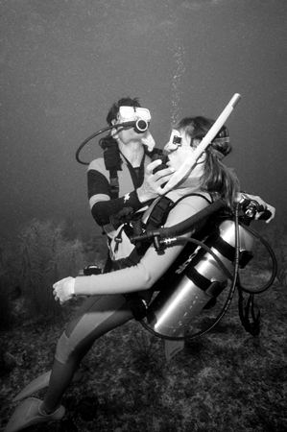
Topics In This Chapter
Accident Prevention
Signs of Trouble Underwater
Underwater Emergencies
Major Barotrauma
Marine Life Injuries

Slide 3
Emergencies Underwater
Naturally a diver is exposed to certain risks
Hyperbaric (high pressure) environment
Temperature considerations
Physical hazards including currents, entanglement, and hostile marine life
Poor judgment: most common factor in accidents

Slide 4
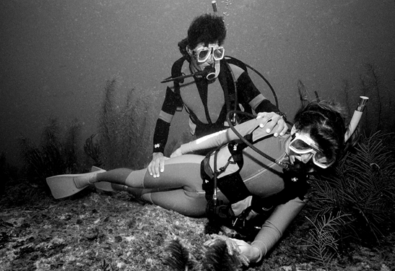
Emergencies Underwater
Unconsciousness is the most serious
underwater emergency
The priority is to get an unconscious diver to the surface as quickly as possible

Slide 5
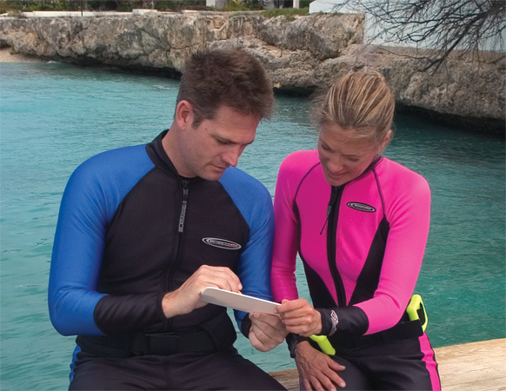
Accident Prevention
Avoid being overtaken by the unexpected
Pre-dive preparation
Dive plan

Slide 6
Accident Prevention
Fine tune the dive plan, during the dive,
to accommodate . . .
Changing currents
Thermoclines
Surge
Lingering at areas of interest

Slide 7
Accident Prevention
Most accidents stem from . . .
Actions by a diver
Inactions by a diver
Reactions by a diver

Slide 8
Signs of Trouble Underwater
Watch buddy for indications of a problem
Slower or faster than normal descent or ascent
Poor buoyancy control
Irregular breathing patterns
Erratic movements
Lack of attention

Slide 9
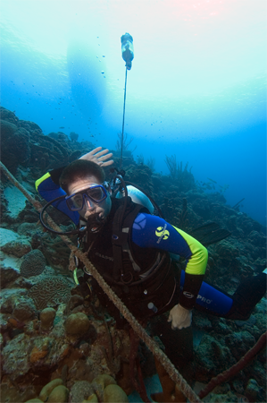
Underwater Emergencies
Entangled Diver
May be avoided by staying aware
Typically involves tank valve, dangling hoses or gauges
If entangled: stop activity, maintain self-control, consider options
Often a diver will be able to back-out of the entanglement
Sometimes a dive knife or other cutting device will be needed

Slide 10
Underwater Emergencies
Carotid sinus reflex
Sensors, located in neck, control blood pressure to brain
Tight hood, collar or neck seal can cause reduction in blood pressure
May result in dizziness, vertigo, or sudden blackout

Slide 11
Underwater Emergencies
Carbon monoxide poisoning
Stems from contaminated compressor intake, or poor compressor maintenance
CO bonds to hemoglobin, and prevents blood from carrying oxygen
May result in headache, tightness across forehead, or sudden collapse

Slide 12
Underwater Emergencies
Nitrogen narcosis
Caused by elevated pressure of nitrogen at depth
May adversely impact thinking and coordination
Other contributing factors include rapid descent, cold, exertion, fatigue, apprehension, and certain drugs
Effects subside upon ascent

Slide 13
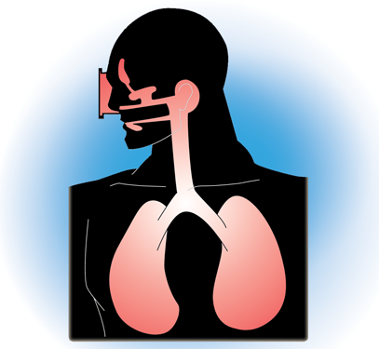
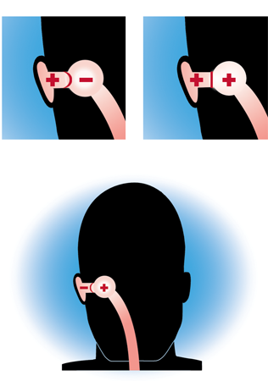
Underwater Emergencies
Squeezes
Caused by an unequalized air space
Natural air spaces: middle ears, sinuses, lungs
Artificial air spaces: mask, dry suit, hood

Slide 14
Major Barotrauma
Barotrauma
Any pressure-related injury

Slide 15
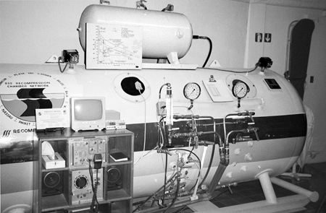
Major Barotrauma
Decompression illness (DCI)
Broad category of major barotraumas
Includes DCS, AGE, other over expansion injuries

Slide 16
Major Barotrauma
Decompression sickness (DCS, “bends”)
Dissolved nitrogen comes out of solution upon ascent, forming bubbles
DCS is avoided by adhering to depth and time limits defined by a personal dive computer or dive tables
Other contributing factors include rapid ascent, over exertion, fatigue, dehydration, hypothermia, hyperthermia, older age, poor physical condition, and certain drugs

Slide 17
Major Barotrauma
Decompression Sickness, continued
Type I: pain, and/or skin rash
Type II: impairment of sensation, motor skills, thought processes, behavior, and/or vital function
May occur shortly after the dive, or up to 24 to 48 hours later
Symptoms often develop gradually, or may quickly cascade

Slide 18
Major Barotrauma
Arterial Gas Embolism (AGE)
Gas bubble passes across alveoli, enters arterial blood flow
If bubble lodges in brain, may produce symptoms similar to stroke
If bubble lodges in coronary artery, may produce cardiac arrest
Onset of symptoms is often immediate and dramatic

Slide 19
Major Barotrauma
Other lung expansion injury (lung rupture)
Mediastinal emphysema: escaping gas gathers around heart and lungs, applying pressure on vital organs
Subcutaneous emphysema: escaping gas gathers under the skin, often near the neck applying pressure on the trachea
Pneumothorax: escaping gas gathers in the pleural sac surrounding the lungs, applying pressure and causing a lung collapse

Slide 20
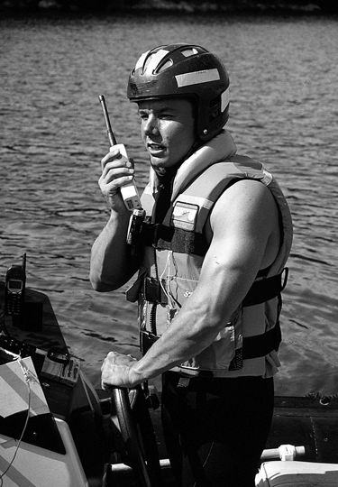
Major Barotrauma
First Aid is the same for all DCI
Activate EMS / seek medical attention
Have patient lie down (left side preferred)
Administer oxygen
Provide fluids (if conscious)
Monitor patient
Treat for shock
Administer CPR when appropriate

Slide 21
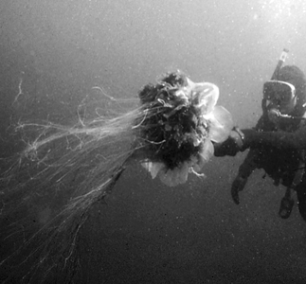
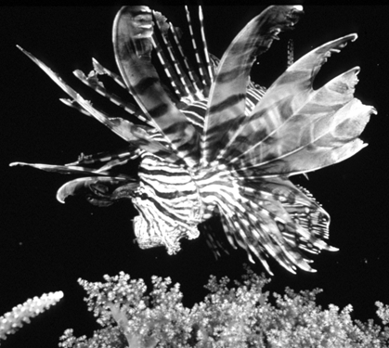
Marine Life Injuries
Punctures – bites and spine wounds
Control bleeding
Clean with fresh water and soap
If spines are embedded in skin, remove if possible
Apply antiseptic / antibiotic
Bandage wound
Seek medical attention when appropriate

Slide 22
Marine Life Injuries
Envenomation
Soak in hot water
Apply constriction bandage
Splint the limb, to limit movement
May be life-threatening; seek medical attention, and be prepared to administer CPR

Slide 23
Marine Life Injuries
Stings – jellyfish and corals
Remove any clinging tentacles (wear gloves)
Neutralize with diluted baking soda paste or ammonia
Clean with fresh water and soap
Sometimes may be life-threatening; seek medical attention when appropriate, and be prepared to administer CPR

Slide 24
Marine Life Injuries
Cuts and scrapes – coral and barnacles
Control bleeding
Clean with fresh water and soap
Apply antiseptic / antibiotic
Bandage wound
Seek medical attention when appropriate

Slide 25
Summary
Underwater emergencies
Most underwater accidents stem from a diver’s actions, inactions, or reactions
Unconsciousness is the most serious underwater emergency
The priority is to get an unconscious diver to the surface as quickly as possible

Slide 26
Scuba I.Q. Review

Slide 27
Scuba IQ Review
1
Q
What indicators might warn you that your buddy may be experiencing problems?
A
Poor buoyancy control
Irregular breathing pattern
Erratic or jerky movements
Not maintaining buddy contact
Disorientation

Slide 28
Scuba IQ Review
2
Q
What are the watchwords to keep in mind in any underwater problem?
A
Stop your activity
Keep your self-control and consider your options

Slide 29
Scuba IQ Review
3
Q
Describe the carotid sinus reflex.
A
When external pressure is applied to the carotid arteries or to the sinuses themselves, the sinuses will react with a reduction in blood pressure and thus a reduction in oxygen to the brain.

Slide 30
Scuba IQ Review
4
Q
What is the danger of carbon monoxide contamination in a diver’s air supply?
A
CO binds readily to hemoglobin, more so than oxygen, leading to insufficient oxygen to vital organs

Slide 31
Scuba IQ Review
5
Q
What is the best way to deal with nitrogen narcosis problems?
A
Narcosis passes quickly as the diver rises to shallower depths and disappears completely on ascent

Slide 32
Scuba IQ Review
6
Q
Describe the physics of an ear squeeze.
A
An imbalance of pressure outside pressing on the eardrum and causing it to flex inward

Slide 33
Scuba IQ Review
7
Q
Why is the BC a factor in dry suit squeezes?
A
Divers who use their BC to control their buoyancy may suffer a suit squeeze if air is not added to the suit

Slide 34
Scuba IQ Review
8
Q
What is a barotrauma?
A
Any pressure related injury

Slide 35
Scuba IQ Review
9
Q
Why is recommended ascent rate only 9m/ 30ft per minute?
A
Most dive computers have an ascent rate of 30 ft per minute, allowing the diver’s physiology to catch up with the physics

Slide 36
Scuba IQ Review
10
Q
List some contributing factors to the occurrence of decompression sickness
Heavy smoking
Alcohol abuse or abuse of other drugs
Fatigue before the dive
Obesity
Dive conditions
A
Dehydration
Hypothermia and heat related injuries
Working hard
Poor physical condition

Slide 37
Scuba IQ Review
11
Q
What is the difference between Type I and Type II bends?
A
Type I: May produce a rash like reddening of the skin, usually on the upper body and arms and may be accompanied by mild, transient joint pain; joint pain is more common and often exists in the absence of skin involvement
Type II: Any sign that demonstrates impairment of motor skills, thought process, or behavior

Slide 38
Scuba IQ Review
12
Q
What is the on-scene treatment of choice in the event of decompression sickness?
A
Keep the victim calm, cool and relaxed. Deliver high flow oxygen to the victim for as long as possible during transport to a dive physician

Slide 39
Scuba IQ Review
13
Q
How does a lung over-expansion injury happen?
A
Temporary or permanent lung blockage, breath holding

Slide 40
Scuba IQ Review
14
Q
List the most common signs and symptoms of a lung over-expansion injury
A
Shortness of breath
Pain in the center of the chest
Rapid erratic pulse
Signs and symptoms of shock
Swelling around the neck
Possible voice changes

Slide 41
Scuba IQ Review
15
Q
Why is a lung over-expansion injury immediately life threatening?
A
Bubbles of air that escape from the lungs can travel to all parts of the body

Slide 42
Scuba IQ Review
16
Q
Why is decompression sickness a venous gas embolism and bubbles in the blood from a lung over-expansion injury an arterial gas embolism?
A
Arterial gas embolism takes place on the arterial side of the circulation as air moves through the alveoli into the blood, as opposed to DCS nitrogen bubbles on the venous side of the circulation where bubbles form as the nitrogen is moving out of the tissues and back towards the lungs

Slide 43
Scuba IQ Review
17
Q
Describe the signs and symptoms of a venomous puncture wound from a lionfish or stonefish.
A
Punctures from the spines produce an immediate intense pain that persists for many hours. The victim may show signs of weakness, nausea and vomiting; cardiac arrest is possible.

Slide 44
Scuba IQ Review
18
Q
Describe how you would handle the tentacles of a stinging jellyfish
A
With golves

Slide 45
Any Questions ?

